Slide 1
Data and Control Hazards Simulation
Supervised by:
Dr. Mai Salama

Slide 2

Team Members
Ahmed Nashaat
Omar Mostafa
Kariem Alaa
Mohamed Sherif

Slide 3

Introduction
Data hazard in pipelining arises when one instruction is dependent on the results of a preceding instruction and that result has not yet been calculated.
Control hazard occurs whenever the pipeline makes incorrect branch prediction decisions, resulting in instructions entering the pipeline that must be discarded. A control hazard is often referred to as a branch hazard.

Slide 4
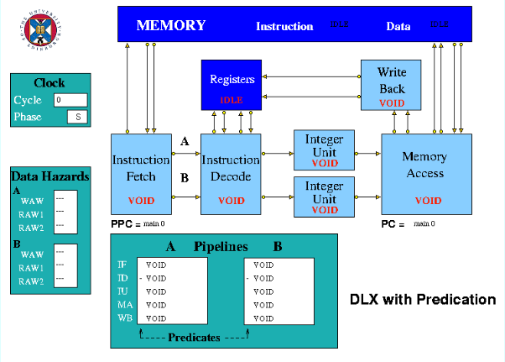
Simulation Model
The HASE Predication Model is based on DLX architecture.
Model consists of:
1.Five stages of the standard simple DLX pipeline with two integer units.
2.Scoreboard to display the data hazards that occurs.
3.Pip_Disp to display the instruction inside the pipeline
4.CPHASE to display the clock number and the phase.

Slide 5

Five stages of DLX pipeline
The Instruction Fetch unit sends an instruction along each of the two data paths to the Instruction Decode unit. The register file can supply the values of four registers in the same cycle
The Instruction Decode unit sends an instruction to each of the two Integer Execution units.
The Memory Access unit receives results from both Execution units. It accesses the predicate registers and determines whether or not each instruction is to complete
Finally, the instruction will proceed to Write back unit if its predicate register is true

Slide 6

Units Held Mode
If the IF unit decodes a branch, it enters Held mode, waiting for the branch to be executed by the memory access unit.
Before accessing operands from the Registers, it checks for hazards. If a hazard is detected, the Unit enters the Held state and the instruction remains in the Instruction Decode Unit until the next clock, when the checks are repeated.

Slide 7
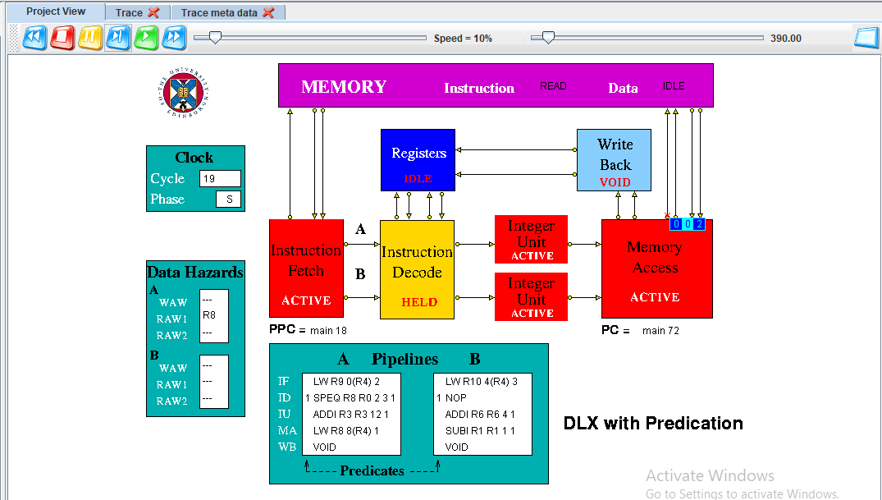
Example of Held Mode

Slide 8
DLX Model instruction set
DLX arithmetic assembly code instructions are of the form: func rd <- rs1 rs2, for example: ADD R1 R2 R3 means R1 = R2 + R3
Load instructions are of the form: LW R1 4(R0). load R1 with the value in the memory location whose address is formed by adding 4 to the contents of R0
Store instruction are of the form: SF 32(R7) F3. write the value in F3 into the memory location whose address is formed by adding 32 to the contents of R7
For compare instructions, the instruction is 70 bits fetched as two successive 35-bit words, each half consists of an instruction with an additional 3-bit field to specify which of the predicate registers the instruction is predicated on.

Slide 9
DLX Model instruction set
The DLX has a delayed branch mechanism which means that the instruction immediately following a branch is executed regardless of the outcome of the branch.
The DLX-Pred instruction set includes a set of comparison instructions which set a pair of specified predicate registers, one to true and one to false, depending on the result of the comparison. These instructions are named similarly to the DLX compare instructions, but with the addition of a P, to show that they set predicate registers rather than general purpose registers. Thus, the instructions are SPEQ, SPNE,SPGT, SPGE, SPLT and SPLE

Slide 10
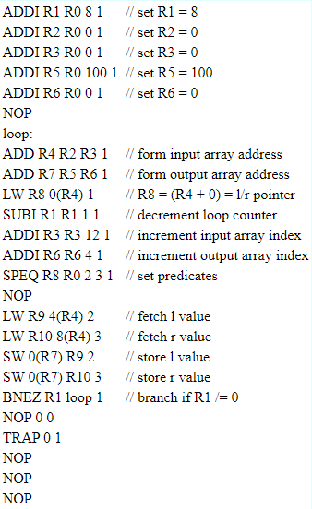
Demonstration Program
if a[i].ptr != 0
{b[i] = a[i].l;}
else
{b[i] = a[i].r;}
i = i + 1;

Slide 11
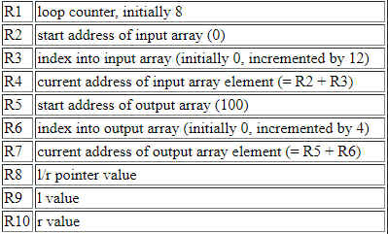
Register Assignment

Slide 12
Handle Control Hazards with Traditional Branch Prediction
Modern processors have sophisticated methods for branch prediction such as branch history tables and correlating predictors, which greatly reduce the number of mis predicted branches.
However, the penalty for a mis predicted branch is still large, involving stalling the pipeline and beginning to fetch instructions again from the branch target address.
These stalls, while less frequent with the use of branch prediction hardware still have a significant effect on performance. Typically, a misprediction rate of 5-10% may slow the processor down by as much as 30-40%.

Slide 13
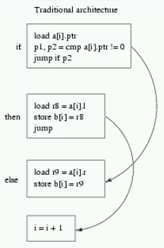
Traditional branch prediction solution
The value of a[i].ptr is loaded from memory and used as the condition for a conditional branch.
In a traditional architecture this code is scheduled as four basic blocks the compare, the if part, the else part, and the add instruction which follows the conditional statement.
Clearly, the result of the compare is difficult to predict. Even if a prediction scheme is used, it cannot correctly predict every time, and the penalty for an incorrect prediction is a pipeline stall costing several clock cycles.

Slide 14

How does the DLX-pred model handle Control hazards?
The HASE model use predication technique to reduce pipeline stalls due to control hazards.
Predication allows branches to be removed from the code by executing both the if and else parts of a branch in parallel, removing the problem of mis predicted branches.
Predication relies on the parallel execution of both instruction paths and thus requires the architecture to feature multiple instruction issue

Slide 15
Example of a Microprocessor that uses Predication
The Intel IA-64 is an example of a commercial microprocessor that uses predication.
Most instructions in the IA-64 can have a predicate tag appended to them by the compiler.
The instruction will only be allowed to write its result if the corresponding predicate is true.
A branch construct can be rewritten using predication by making the if part predicated on a certain predicate register and the else part predicated on a complimentary register.
Since only one of the pair of predicate registers holds true, only one of the paths through the branch will write its result.

Slide 16
Predicate Registers
The predicate registers are contained in the Memory Access unit which is the only unit which ever requires access to them.
If the predicate for an instruction is true, the instruction may proceed as normal. However, if the predicate is false, the instruction is terminated, does not read or write memory and does not proceed to the Write Back unit if it otherwise would
It is also in the Memory Access unit that the result of the compare arrives, so it is simple to write the result into predicate registers in that unit.
Keeping predicate registers in Memory Access, rather than with the general-purpose registers, eliminates the need for any forwarding of predicates and hazard detection.

Slide 17
The SPEQ instruction
The SPEQ (set predicate equal) instruction is a predicate instruction in the DLX-Pred architecture that sets the predicate bit of the current instruction to 1 if two register operands are equal, and to 0 otherwise.
SPEQ R4 R2 R3, P0 // set predicate bit to 1 if R2 = R3
ADDI R5 R5 4, P0 // increment R5 by 4 if R2 = R3
ADDI R6 R6 1, P0 // increment R6 by 1 if R2 = R3
NOP
The subsequent ADDI and NOP instructions are then executed conditionally based on the value of the predicate bit, which controls whether they are executed or skipped..
The SPEQ instruction is typically used in conjunction with predication to conditionally execute instructions based on the outcome of a comparison.

Slide 18
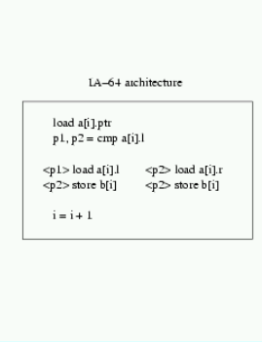
Predication solution
The code is scheduled by the compiler as a single basic block with the two possible paths through the conditional statement executing in parallel, controlled by the value of predicate registers.
After the load instruction, a new compare instruction, cmp, compares the loaded value with zero, and sets the pair of predicate registers.
The true predicate p1, is set if the compare was true, and the false predicate p2, is set if the compare was false.
Only the path with the true predicate is allowed write its result to memory, the other instruction being ignored.

Slide 19
How does the model handle Data hazards?
In the HASE DLX model the registers are implemented as C++ structs with three fields:
1.Register number.
2.Value and
3.Use bit.
The Scoreboard handles data hazards through Use bits. Each register has a Use bit which is set when an instruction that will write to the register is issued and reset when the result is written to the register.

Slide 20
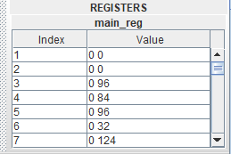
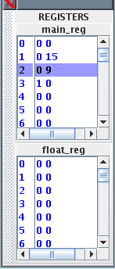
Example on handling data hazards
Main Register 3 has its Use bit set, while all the others are in the reset state.
Register 2 is highlighted because it was the last one to be accessed.
Before accessing a source or destination register, the Instruction Decode Unit invokes a class in the Registers entity which reads the relevant Use bit.
If the Use bit for a Register required as a source operand is set, the Scoreboard registers a RAW hazard
If the Use bit for a Register required as a destination operand is set, the Scoreboard registers a WAW hazard.

Slide 21
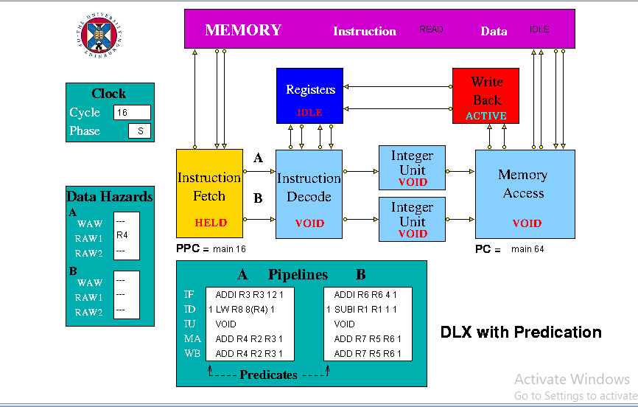
Data hazard example result
There is a (RAW) data hazard at pipeline A
LW R8 8(R4) instruction wait
ADD R4 R2 R3 instruction to write back
IF unit was held

Slide 22
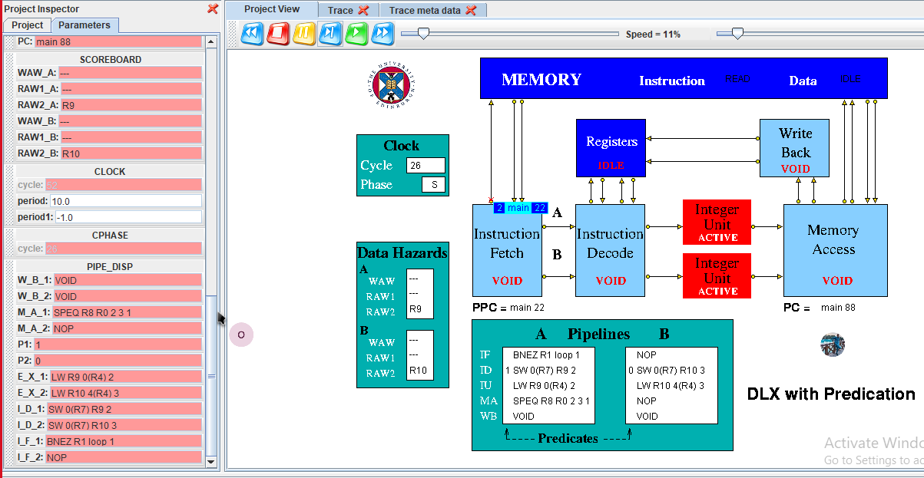
Control Hazard example result

